Slide 1



ARGOS
SHARED GOVERNANCE OF SUSTAINABLE FISHERIES AND AQUACULTURE ACTIVITIES AS LEVERAGE TO PROTECT MARINE RESOURCES IN THE ADRIATIC SEA
Regione Emilia-Romagna

Slide 2

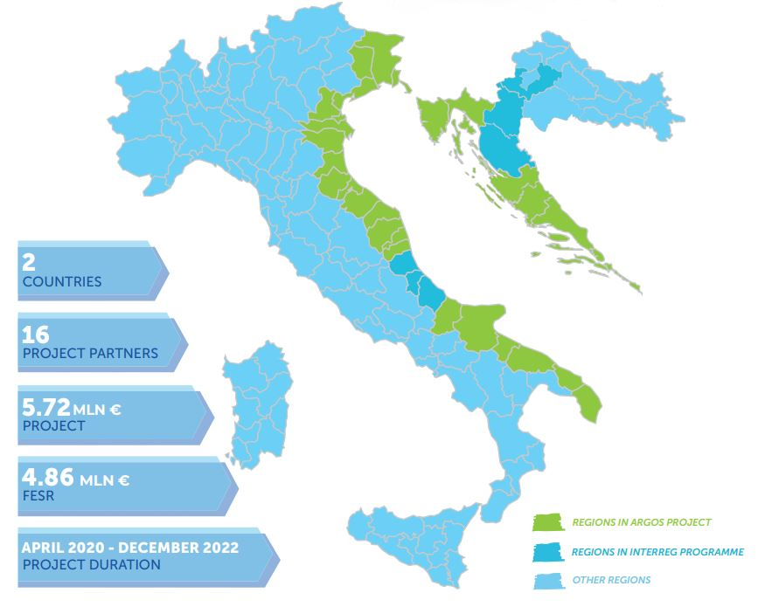

THE NUMBERS

Slide 3
















PARTNERSHIP

Slide 4

ITALIAN PARTNERS
Autonomous Region of Friuli Venezia Giulia
Veneto Region
Emilia-Romagna Region
Marche Region
Molise Region
Apulia Region
National Research Council – Institute for Biological
Resources and Marine Biotechnologies (CNRIRBIM) – Headquarter of Ancona
Italian Ministry of Agriculture, Food and Forestry policies MIPAAF – Associate Partner (Rome)

Slide 5
SISTEMARE CASELLA TESTO
CROATIAN PARTNERS
Region of Istria
County of Primorje and Gorki Kotar
Zadar County
Public Institution Development Agency of Šibenik-Knin County
Public Institution RERA SD for Coordination and Development of Split-Dalmatia County
Dubrovnik-Neretva County
Institute of Oceanography and Fisheries – IOF (Split)
Croatian Ministery of Agriculture - Associate Partner (Zagreb)

Slide 6
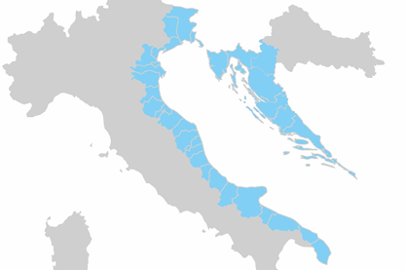

ARGOS MOTTO:
«Environmental and social economic sustainability, common aim to protect the resources of the Adriatic sea»
ARGOS has been funded by the call for strategic projects of the Interreg Programme Italy-Croatia within the Priority Axis “Environment and Cultural Heritage” with the specific aim 3.2 “Contribute to protect and restore biodiversity”.

Slide 7
SPECIFIC OBJECTIVES
1. Establishing and encouraging a common coordinated framework and strenghtening the Institutional dialogue for a sustainable and shared management of Adriatic marine resources. | 2. Protecting Adriatic fishing resources according to the decisional processes shared with the best available “know-how”.
ARGOS puts together Adriatic Institutions dealing in fisheries and aquaculture and Argos partners to act as a whole for the sustainable fishing activities through the Adriatic Advisory Committee (AAC), by representing the Adriatic basin needs at European and international level. | ARGOS is based on a scientific approach for a common strategy related to fish stocks and the eco-biological status of habitat and marine species. ARGOS will guarantee continuos scientific advice and consultations with stakeholders for specific studies on the marine space of the Adriatic area and for the evaluation of fisheries and aquaculture data.

Slide 8

SPECIFIC OBJECTIVES
3. Improvement of fishing techniques oriented toward environmental sustainability.
ARGOS aims to create a network wishing to help the cross-border exchange of information and expertise among operators in the fishing industry, improve their sectorial skills and direct them on responsible behaviours toward the environmental sustainability thanks to a specific training and dedicated labs.

Slide 9



THE MAIN OBJECTIVE OF ARGOS
ARGOS promotes and shares a common approach to protect marine resources and to preserve a healthy environmental status in the Adriatic sea, through institutional and operative actions oriented to harmonise fisheries and acquaculture activities in marine habitats adopting a sustainable way.

Slide 10



THE MAIN OBJECTIVE OF ARGOS
ARGOS promotes and shares a common approach to protect marine resources and to preserve a healthy environmental status in the Adriatic sea, through institutional and operative actions oriented to harmonise fisheries and acquaculture activities in marine habitats adopting a sustainable way.

Slide 11
PROJECT OUTPUTS
A scientific approach based on institutional dialogue aimed at defining coordinated and shared policies for the protection of Adriatic marine resources.
The legitimacy of harmonized processes for the definition of sustainable policies at environmental and economic level by Adriatic institutions, skilled in the management of fishing activities.
Measures and models to minimise the environmental impact of fishing activities on habitats and marine species.

Slide 12
PROJECT OUTPUTS
4. A common coordinated framework of scientific and social-economic databases for a sustainable management of fisheries and aquaculture activities and the definition of “ad hoc” policies.
5. Means and tools made available to sector operators for an improved exchange and development of their specific knowledge.
6. Increased technical awareness of fishermen and aquaculture operators and focused on adopting sustainable behaviors within the fishing supply chain.

Slide 13
PROJECT “WORK PACKAGES”
WP1 - PROJECT MANAGEMENT AND ACTIVITIES COORDINATION
Start-up and administration activities
WP2 - COMMUNICATION ACTIVITIES
Start-up activities and communication strategy
WP3 – GOVERNANCE FRAMEWORK
Activity 3.1 - Establishment and functioning of the governance framework
Activity 3.2 - Maritime Spatial Planning assessments
Activity 3.3 - Assessment of interactions between environmental management and socio-economic effects
Activity 3.4 - Update of crossborder management models for fisheries according to projects findings

Slide 14
PROJECT “WORK PACKAGES”
WP4 – KNOWLEDGE-BASED DECISION-MAKING PROCESS
Activity 4.1 - Survey and comparison of existing data and databases
Activity 4.2 - Common scheme for the management of fishery activities at local level
WP5 – SECTORIAL KNOW-HOW DEVELOPMENT AND PILOT PROJECT IMPLEMENTATION
Activity 5.1 - Network for the training and education of operators towards environmental sustainability
Activity 5.2 - Improvement of fishermen behaviours
Activity 5.3 - Improvement of aquaculture operators behaviours

Slide 15

TARGET GROUP
Genera
Protected l Public
Local, regional and national public authoritiesareas/ natural heritage management bodies
Regional and local development agencies
Associations
Education and training organizations as well as universities and research institutes

Slide 16





FOR MORE INFORMATION ABOUT ARGOS: Websites and social media
https://www.italy-croatia.eu/web/argos
https://www.facebook.com/Argos.Interreg.ItalyCroatia/
https://www.instagram.com/argos_interreg_italy_croatia/
ARGOS Interreg Italy-Croatia

Slide 17
WP2 Responsible emilia-romagna region
Organisation name: Emilia-Romagna Region
Via Della Fiera, 8 Bologna (Bo)
Contacts:
Project Manager - Piergiorgio Vasi - piergiorgio.vasi@regione.emilia-romagna.it
Luca Chiodini – Communication Manager - luca.chiodini@regione.emilia-romagna.it
Greta Santagostino Pretina – Communication & Social Media Assistance – greta.santagostino@regione.emilia-romagna.it
Demetrio Li Pera - Financial Manager - demetrio.lipera@regione.emilia-romagna.it
Michela Sivelli – Accounting and Financial Assistance - michela.sivelli@regione.emilia-romagna.it

Slide 18



